Slide 1
Web programming

Slide 2
Module 2
(CSS, JavaScript) Introduction to Stylesheets : Introduction to CSS-Basicsyntax and structure-Inline Styles, Embedded Style Sheets, Conflict Resolution, Linking External Style Sheets-Exploring CSS Selectors-Properties, values, Positioning Elements: Absolute Positioning, RelativePositioning - Backgrounds-List Styles-Element Dimensions- Table Layouts-Box Model and Text Flow-div and span -Basics of Responsive CSS, Mediaport & Media Queries.

Slide 3
Introduction to JavaScript : Introduction to Scripting- Programming fundamentals of JavaScript -Obtaining User Input with prompt Dialogs-Arithmetic-Decision Making -Control Statements - Functions -Arrays -Objects -Document Object Model (DOM) -Form processing

Slide 4
Introduction to CSS3
Cascading Style Sheets 3 (CSS3) that allows you to specify the presentation of elements on a web page (e.g., fonts, spacing, sizes, colors, positioning)separately from the document’s structure and content (section headers, body text, links, etc.).
CSS is a set of rules for displaying markup content.CSS made the Separation of structure from presentation multiple style sheets can be applied to the same Web page

Slide 5
Same style sheet can be applied to the multiple Web page
Cascading:
Display rules “cascade” down
The most specific rule is used
Styles Sheet:
Rules are created as styles

Slide 6
Advantages of CSS3
Saves time
Easy to change
Keep consistency(always behave in the same way)
more control over layout
Use styles with JavaScript => DHTML
create a common format for all theWeb pages

Slide 7
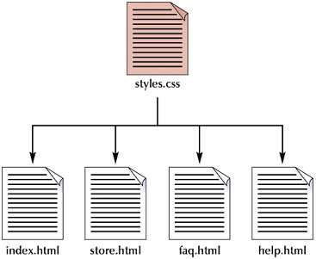

Slide 8
Types of CSS
Inline style sheet
The style properties are added within the HTML tag itself
Embedded style sheet
The set of style properties are embedded within the HTML document
External style sheet
Common set of style properties are applied to all the web pages from an external .css file.

Slide 9
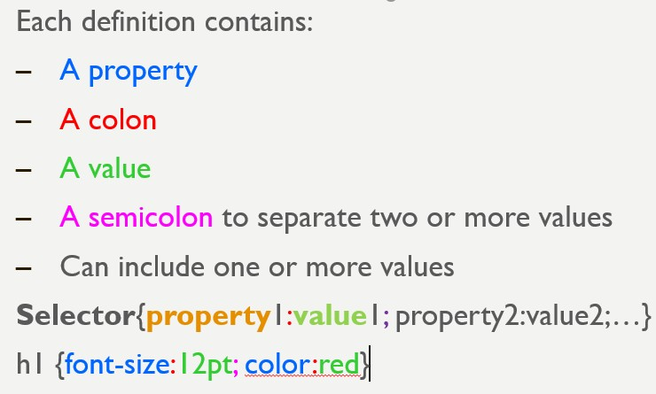

Slide 10
Order of Precedence of Style Sheet
Inline style sheets(lowest level)
Embedded/Document Level sheets
External style sheets(highest Level)
Inline Style sheets have precedence over document style sheets which have precedence over external style sheet.
When using multiple styles that conflict, which will be displayed?
Order:
Inline style sheet
Embedded style sheet
External style sheet
Browser default

Slide 11
Style Specification Format
Inline Style
Style=“property0:value0;property1:value1;
………
propertyZ:valueZ;”
Document Level
<style type=“text/css”>
rule_list
</style>
Each style rule in a rule list has two parts
Selector—the tag or tags affected by the rule.
List of property/value pairs
Selector { property_1: value_1; property_2: value_2:… property_n: value_n;}

Slide 12
Style Specification Format
External Style sheet
<link href=URL rel=“relation_type” type=“link_type”>
URL is the file.css
Relation_type=“stylesheet”
Link_type=“text/css”
Do not include <style> tags
Save the document as filename.css

Slide 13
Inline styles
Add styles to each tag within the HTML file
Use it when you need to format just a single section in a web page
style information is directly attached to the HTML elements they affect
Attribute style,followed by a colon and a value
<h1 style=“color:red; font-family: sans-sarif”>India is my country</h1>

Slide 14
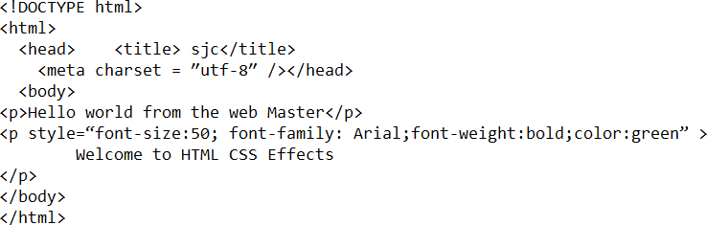

Slide 15
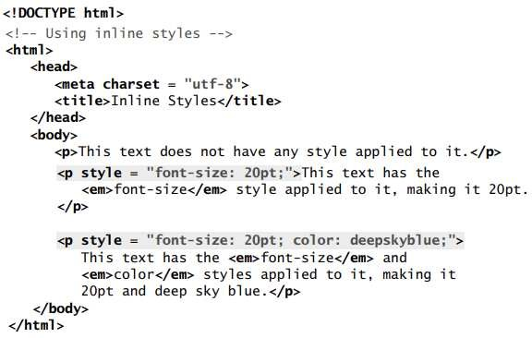
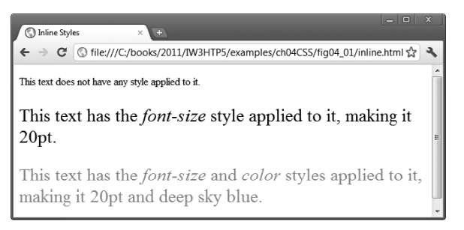

Slide 16
Inline styles
Attribute style specifies an element’s style.
Each CSS property (font-size in this case) is followed by a colon and a value the two properties, font-size and color are separated by a semicolon.
set the given paragraph’s color to deepskyblue. Hexadecimal codes may be used in place of color names.
Figure contains the HTML standard color set.
A complete list of HTML standard and extended colors at www.w3.org/TR/ css3-color/

Slide 17
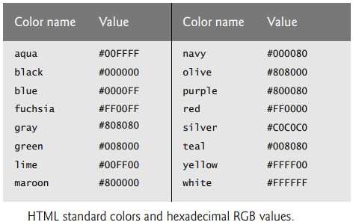

Slide 18
Embedded / internal/Document level
A style is applied to the entire HTML file.Use it when you need to modify all instances of particular element (e.g., h1) in a web page
Example
<style type=“text/css”>
h1 {color:red; font-size:20;font-family:monospace}
</style>
<head>
<title>Embedded Example</title>
<style type=“text/css”>
Style declarations
</style>
</head>

Slide 19


Slide 20
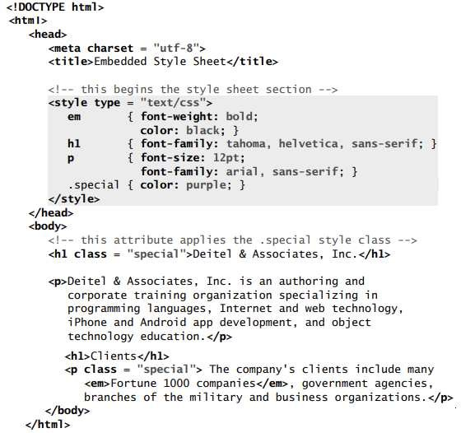

Slide 21


Slide 22
Embedded / internal/Document level
Styles placed in the head apply to matching elements wherever they appear in the body.
The style element’s type attribute specifies the MIME (Multipurpose Internet Mail Extensions) type that describes the style element’s content.
CSS documents use the MIME type text/css

Slide 23
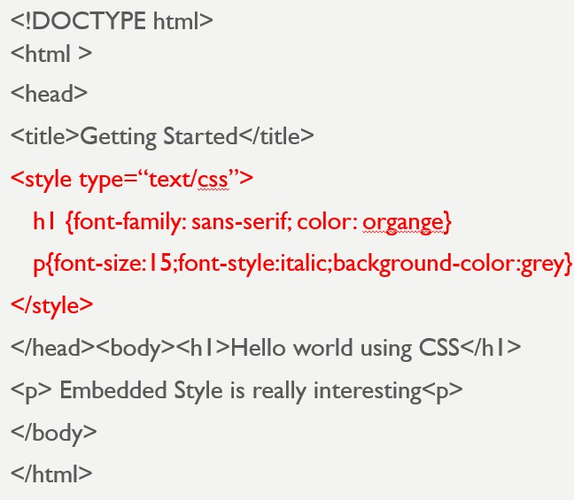

Slide 24
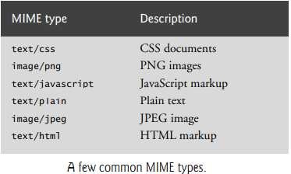

Slide 25
External style sheets
Style sheets are a convenient way to create a document with a uniform theme.
With external style sheets (i.e., separate documents that contain only CSS rules), you can provide a uniform look and feel to an entire website (or to a portion of one).
You can also reuse the same external style sheet across multiple websites.
Different pages on a site can all use the same style sheet.
When changes to the styles are required, you need to modify only a single CSS file to make style changes across all the pages that use those styles. This concept is sometimes known as skinning.

Slide 26
While embedded style sheets separate content from presentation, both are still contained in a single file, preventing a web designer and a content author from conveniently working in parallel.
External style sheets solve this problem by separating the content and style into separate files

Slide 27
An external style sheet is a .css file containing the style definition (declaration)
Use it when you need to control the style for an entire web site
Example
h1, h2, h3, h4, h5, h6 {color : red; font-family : sans-serif}
Save this in a new document using a .css extension

Slide 28
Creating an External Style Sheet
Open a new blank document in Notepad
Type style declarations
h1 {color:red; font-family:sans-serif;}
Do not include <style> tags
Save the document as filename.css

Slide 29
Linking to Style Sheets
Open an HTML file
Between <head> and </head> add
<link href=URL rel=“relation_type” type=“link_type”>
URL is the file.css
Relation_type=“stylesheet” and Link_type=“text/css”
Save this file and the .css file in the same web server directory

Slide 30
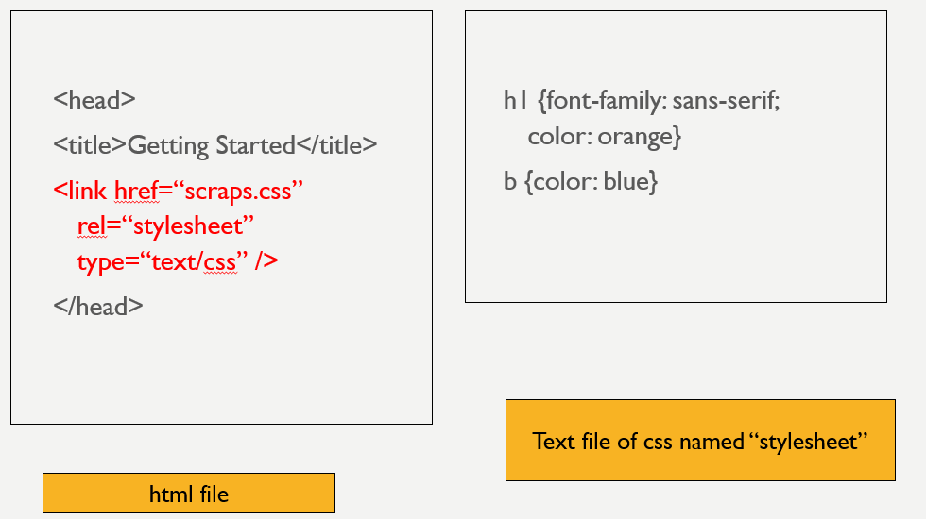

Slide 31
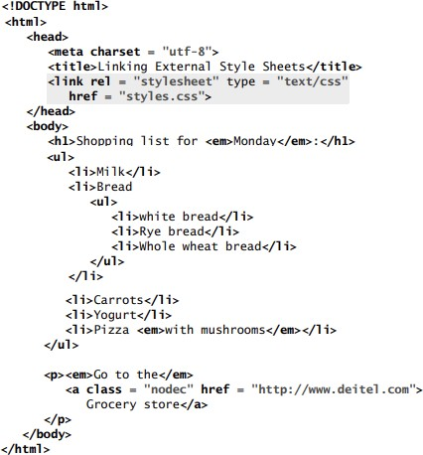

Slide 32
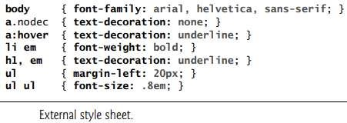

Slide 33
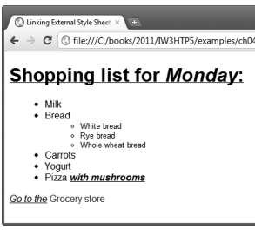

Slide 34
Conflict Resolution
Styles may be defined by a user, an author or a user agent.
A user is a person viewing your web page, you’re the author—the person who writes the document—and the user agent is the program used to render and display the document (e.g., a web browser).

Slide 35
Styles cascade (and hence the term “Cascading Style Sheets”), or flow together, such that the ultimate appearance of elements on a page results from combining styles defined in several ways.
Styles defined by the user take precedence over styles defined by the user agent.
Styles defined by authors take precedence over styles defined by the user.
Most styles defined for parent elements are also inherited by child (nested) elements

Slide 36
There are certain properties that you don’t want to be installed.
For example, the background-image property allows you to set an image as the background of an element.
If the body element is assigned a background image, we don’t want the same image to be in the background of every element in the body of our page. Instead, the background-image property of all child elements retains its default value of none.
There are some rules for resolving conflicts between styles defined for elements and styles inherited from parent and ancestor elements

Slide 37
Properties defined for child and descendant elements have a higher specificity than properties defined for parent and ancestor elements.
Conflicts are resolved in favor of properties with a higher specificity, so the child’s styles take precedence

Slide 38
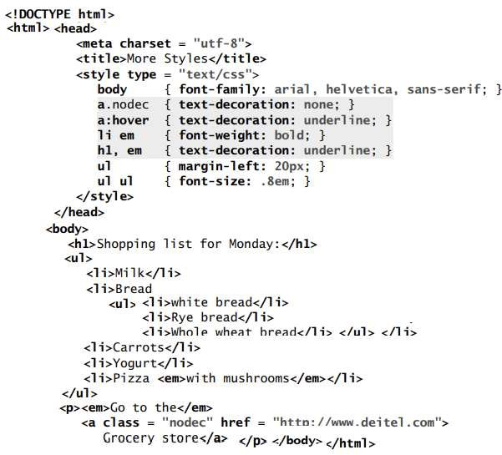

Slide 39
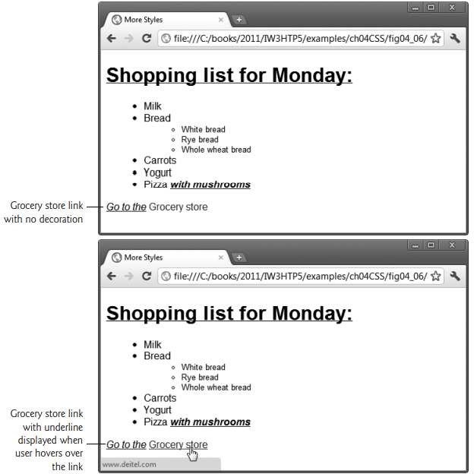

Slide 40
Exploring CSS Selectors
Css selectors are used to find or select the html elements you want to style.
There are six different selector forms
Simple selector
Class selector
Generic selector
Id selector
Universal selector
Pseudo classes

Slide 41
Exploring CSS Selectors- Simple selector
Simple selector form is a list of style rules, and property values in the rule apply to all occurrences of the all of the named element
The selector is a tag name or a list of tag names, separated by commas
Ex) h1, h3 { font-size: 24pt ;} h2 { font-size: 20pt ;}
Contextual selectors: Selectors can also specify that the style should apply only to elements in certain positions in the document

Slide 42
Ex) selector applies its style to the content of italic elements that are descendants of bold elements in the body of the document.
body b i {font-size: 24pt ;}
Also called as descendant selectors

Slide 43
Exploring CSS Selectors- Simple selector
Used to allow different occurrences of the same tag to use different style specifications.
HTML and XHTML require each id be unique– therefore an id value can only be used once in a document.
You can mark a group of elements with a common identifier using the class attribute.
<element class=“class”> … </element>

Slide 44
A style class has a name, which is attached to the tag‘s name with a period.
p.ques{property-value list} p.ans {property-value list}
<p class = “ques"> What is WWW?</p>
<p class = “ans"> WWW is World wide web,an information repository which can be accessed over internet</p>

Slide 45
<!DOCTYPE html>
<html lang = ″en″> <head> <title> sjc</title> <meta charset = ″utf-8″ />
<style type = "text/css">
p.regtext {font-family: Times; font-size: 14pt; width: 800px}
p.abstext { position: absolute;top: 125px; left: 50px; font-family: Times; font-size: 24pt; font-style: italic; width: 500px}
</style> </head> <body>
<p class = "abstext"> APPLES ARE GOOD FOR YOU </p>

Slide 46
<p class = "regtext"> Apple is the common name for any tree of the genus Malus, of the family Rosaceae. Apple trees grow in any of the temperate areas of the world. Some apple blossoms are white, but most have stripes or tints of rose. Some apple blossoms are bright red. Apples have a firm and fleshy structure that grows from the blossom. The colors of apples range from green to very dark red. The wood of apple trees is fine-grained and hard. </p>
<p class = "abstext"> ORANGES ARE GOOD IN SUMMER </p>

Slide 47
<p class = "regtext"> Oranges the common name for any tree of Orange. trees grow in any of the temperateareas of the world. Some orangaes blossoms are white, but most have stripes or tints of rose. </p>
</body>
</html>

Slide 48
Generic Selector
A generic class can be defined if you want a style to apply to more than one kind of tag.
A generic class must be named, and the name must begin with a period without a tag
Example: .really-big { … }
<h1 class = "really-big"> ADMISSION</h1>...
<p class = "really-big"> BTECH ADMISSION 2022… </p>
<h2 class = "really-big"> BHRM ADMISSION 2022… </h2>
<h3 class = "really-big"> PG ADMISSION 2022… </h3>

Slide 49
<!DOCTYPE html><html lang = ″en″>
<head> <title> sjc</title> <meta charset = ″utf-8″ />
<style type = "text/css">
.regtext {font-family: Times; font-size: 14pt; width: 800px}
.admstext { position: absolute;top: 125px; left: 50px; font-family: Times; font-size: 24pt; font-style: italic; width: 500px}
</style>
</head>
<body>

Slide 50
<h1 class = “admstext"> SJCET ADMISSION</h1>.
<p class = "regtext">SJCET structure that grows from the blossom. Minority catholic institution .provides Btech and MTECh courses</p>
<p class = “admstext"> SJCET BTECH ADMISSION 2022… </p>
<p class = "regtext">SJHMCT hotel management institution . Minority catholic institution .provides BHRM
courses</p>

Slide 51
<h2 class = “admstext"> SJCET BHRM ADMISSION 2022… </h2>
<h3 class = “admstext"> SJCET PG ADMISSION 2022… </h3>
<p class = "admstext"> PG courses MTECH,MBA,MTECH available at SJCET</p>
</body> </html>

Slide 52
Id Selector
An id selector allow the application of a style to one specific element.
Style specified in the id selector applies to the element with the given id.
To create an ID for a specific tag, use the property:
<tag id=“id_name”>
To apply a style to a specific ID, use: #id_name {style attributes and values}
The general form of an id selector is as follows : #specific-id {property-value list}
Example:
#section14 {font-size: 20} specifies a font size of 20 points to the element
<h2 id =“section14”> Alice in wonderland</h2>

Slide 53
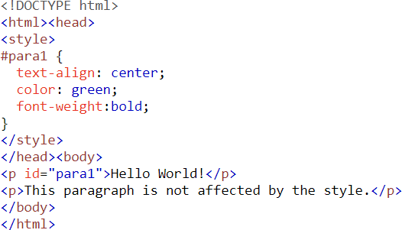

Slide 54


Slide 55
Universal Selector
The universal selector, denoted by an asterisk(*), which applies style to all elements in the document.
For example:
*{color: red;}
makes all elements in the document red. Is not often useful.

Slide 56
Pseudo Classes
A pseudo-class is used to define a special state of an element.
Style an element when a user moves the mouse over it
Style visited and unvisited links differently
Style an element when it gets focus

Slide 57
Pseudo classes are styles that apply when something happens, dynamically instead of simply displaying the target element
Names of pseudo classes begin with colons hover classes apply when the
mouse cursor is over the element focus classes apply when an element has focus
i.e. the mouse cursor is over the element and the left mouse button is clicked

Slide 58


Slide 59
<html >
<head> <title> Style for Input Type Text </title>
<style type = "text/css">
input:hover {color: red;border-top:dotted;}
input:focus {color: green;border-color:yellow;}
</style>
</head>
<body>
<form action = "">
<p> Your name: <input type = "text" /> </p>
</form>
</body>
</html>

Slide 60
Anchor Pseudo Classes
Links can be displayed in different ways.
We can modify the way hyperlinks appear by creating style rules modifying the <a> tag with the following “pseudo-classes”:
link
visited
hover
active
a:link {color:#0000ff} a:visited {color: #00ff00}
a:hover {color:fuschia; font-weight:bold} a:active {font-size:30pt}

Slide 61
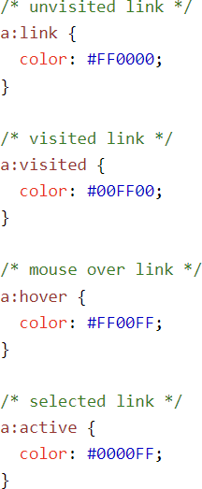

Slide 62
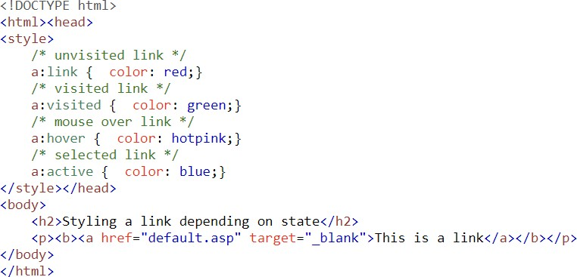

Slide 63
CSS Property
CSS properties are the styles used on specified selectors.
five common properties to work with
List properties
Font properties
Border properties
Text properties
Color Properties

Slide 64
CSS VALUES
Values are written immediately after the colon that separates them from CSS properties
CSS values aren't just text; they come in different forms
Keywords property values are used when there are only a few possible values and they are predefined (not case sensitive)
Eg: small, large, medium.
Number values can be integer or sequence of digits with decimal points and a + or– sign.

Slide 65
Length value are specified as number values that are followed immediately by a two character abbreviation of a unit name.
There can be no space between the number and the unit name.
px for pixels, pt for points, pc for picas (12 points) , in for inches, cm for centimeters, mm for millimeters,

Slide 66
Percentage - just a number followed immediately by a percent sign: eg: font size set to 85% means new font size will be 85% of the previous font size value.
URL values: URL property values use a form that is slightly different from references to URLs in links.
url(protocol://server/pathname)
No space should be left between URL and the left parenthesis.
Colors : Color name rgb(n1, n2, n3).
Hex form: #B0E0E6 stands for powder blue color.

Slide 67
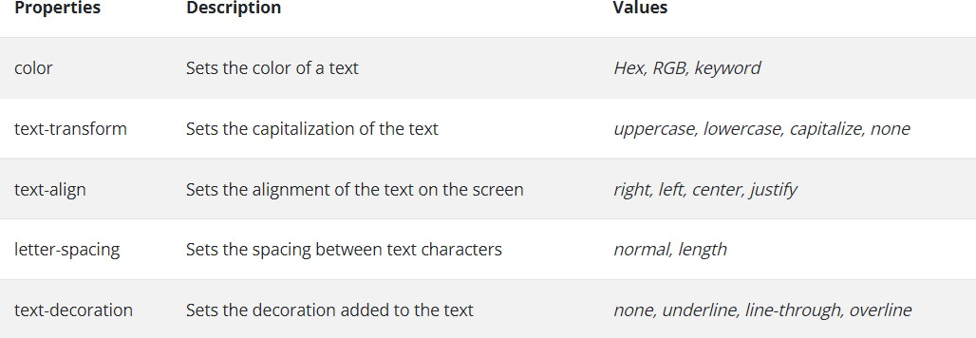
CSS Property- values-TEXT properties

Slide 68
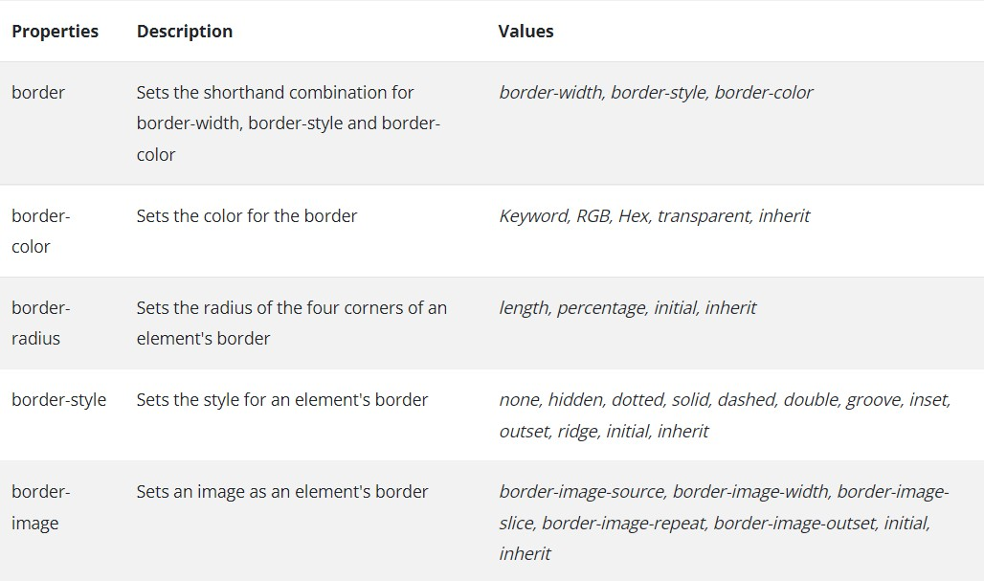

Slide 69
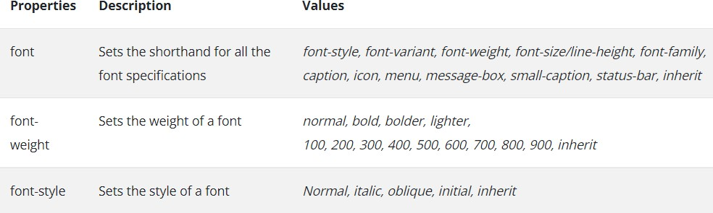

Slide 70
The font-family property is used to specify a list of font name.The browser will use the first font in the list that it supports.
font-family: Arial, Helvetica, Courier
Generic fonts: They can be specified as the font family value for example :serif, sans-serif, cursive, fantasy, and monospace (defined in CSS).
If a font name that has more than one word, it should be single-quoted Eg: font-family: ‘Times New Roman‘

Slide 71
CSS Property- values-Font properties
Font Shorthand
If more than one font property is to be specified than the values may be stated in a list as the value of the font property .
Eg: font: bold 24pt ‘Times New Roman‘ Palatino Helvetica
The order which browser follows is last must be font name, second last font size and then the font style,
font variant and font weight etc can be in any order but before the font size and names.

Slide 72
Font-size -Possible values: a length number or a name, such as smaller, xx-large, medium , large etc.
Font-variant -The default value of the font-variant property is normal, can be set to small-caps to specify small capital characters.
Font-style -The property is most commonly used to specify italic,
Font-weight -The property is used to specify the degree of boldness.
Text Decoration-line-through , overline , underline, none
Text Spacing: letter spacing , word spacing , line-height

Slide 73
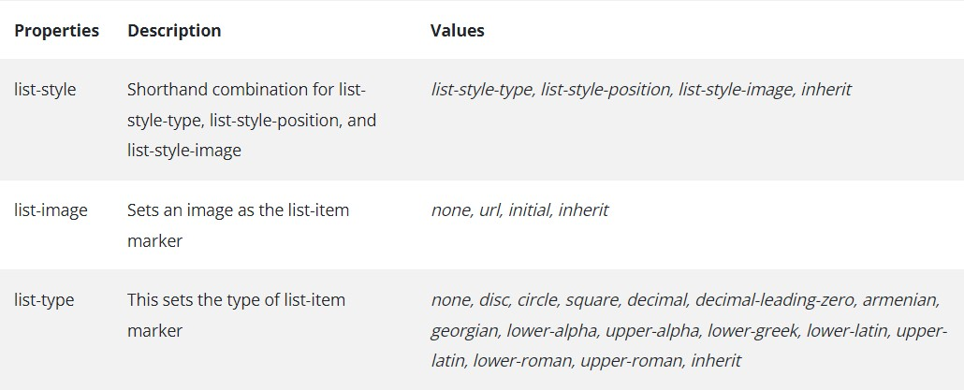
CSS Property- values-List properties

Slide 74
It is used to specify style of bullets or sequencing values in list items.
The list-style-type of Unordered lists can be set to disc,circle,square or none.
Bullet can be a disc (default), a square, or a circle
<li style = "list-style-type: circle">BTECH </li>
Could use an image for the bullets in an unordered list.
Example:
<li style = "list-style-image: url(book.jpg)">

Slide 75
When ordered lists are nested, it is best to use different kinds of sequence values for the different levels of nesting
Decimal Arabic numerals 1, 2, 3, 4
upper-alpha Uc letters A, B, C, D
lower-alpha Lc letters a, b, c, d
upper-roman Uc Roman I, II, III, IV
lower-roman Lc Roman i, ii, iii, iv
<style type = "text/css">
ol {list-style-type: upper-roman;} ol ol {list-style-type: upper-alpha;} ol ol ol {list-style-type: decimal;}
</style>

Slide 76
CSS Property- values-color properties
color –specify the foreground color of html elements color:red
background-coloràset the background color of an element background-color:grey
Web Palette contains , one of 16 million different colors
A set of 16 generic colors that are guaranteed to be displayable
Names for some:
blue, red, green, pink
Hexadecimal
#0000FF, #FF0000, #00FF00, #FF3399
RGB
rgb(0,0,255), rgb(255,0,0), rgb(0,255,0)
RGB%
rgb(0%,0%,100%), rgb(100%,0%,0%)

Slide 77
CSS Property- values-other properties
text-align property has the possible values, left (the default), center, right, or justify.
we want text to flow around another element - the float property.
float property has the possible values, left, right, and none (the default).
Float property is used to specify that text should flow around some element.
text-indent property used to indent the first line of a paragraph

Slide 78
CSS Property- values-Background
CSS provides control over the backgrounds of block-level elements.
CSS can set a background color or add background images to HTML5 element
background-coloràset the background color of an element
background-color:grey
The background-image property is used to place an image in the background of an element
Repetition can be controlled.
Background image can be replicated to fill the area of the element. This is known as tiling. background-repeat property possible values:repeat (default), no-repeat, repeat-x, or repeat-y background-position property. Possible values: top, center, bottom, left, or right.

Slide 79
<html><head> <title> sjc</title><meta charset = “utf-8” />
<style type = "text/css">
body { background-color:grey;background-image:url("agriculture.jfif");background-repeat:repeat-y; background-position:center; }
Img {float:left; }
</style> </head>
<body>
<h1> ADMISSION</h1>.

Slide 80
<img src="alogo.jfif"/><p> structure that grows from the blossom.provides Btech and MTECh courses</p>
<p > BTECH ADMISSION 2022… </p>
<p > hotel management institution . Minority catholic institution .provides BHRM
courses</p> <h2 > SJCET BHRM ADMISSION 2022… </h2>
<h3 > BHRM ADMISSION 2022… </h2><h3 > PG ADMISSION 2022… </h3>
<p> PG courses MTECH,MBA,MTECH available at SJCET</p>
</body> </html>

Slide 81
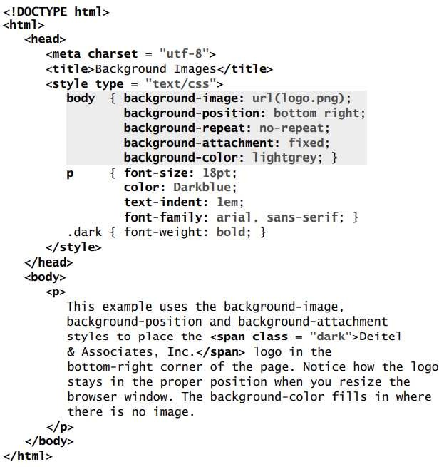
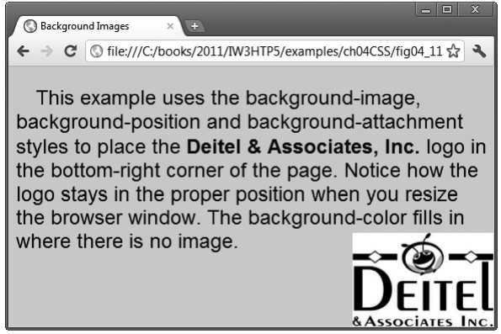

Slide 82
CSS Property- values-Background
background-image Property
The background-image property specifies the image URL for the image logo.png in the format url(fileLocation).
You can also set the background-color property in case the image is not found
background-position Property
The background-position property places the image on the page. The keywords top, bottom, center, left and right are used individually or in combination for vertical and horizontal positioning.
For example, to position the image as horizontally centered (positioned at 50 percent of the distance across the screen) and 30 pixels from the top, use

Slide 84
CSS Property- values-Background
background-attachment
fixed Property The next property setting, background-attachment: fixed , fixes the image in the position specified by background-position. Scrolling the browser window will not move the image from its position.
The default value, scroll, moves the image as the user scrolls through the document.

Slide 85
background-repeat Property
The background-repeat property controls background image tiling, which places multiple copies of the image next to each other to fill the background.
Here, we set the tiling to no-repeat to display only one copy of the background image.
Other values include repeat (the default) to tile the image vertically and horizontally, repeat-x to tile the image only horizontally or repeat-y to tile the image only vertically.

Slide 86
text-indent property to indent the first line of text in the element by a specified amount, in this case 1em.
font-style property formats text is the font-style property, which allows you to set text to none, italic or oblique

Slide 87
Positioning Elements: Absolute Positioning, z-index
The CSS position property is used to set position for an element
CSS introduced the position property ,which gives you greater control over how document elements are displayed
The position property specifies the type of positioning method used for an element.
Elements are then positioned using the top, bottom, left, and right properties. However, these properties will not work unless the position property is set first.
They also work differently depending on the position value.

Slide 88
Absolute Position: An element with position: absolute; will cause it to adjust its position with respect to its parent. If no parent is present, then it uses the document body as parent.
position: absolute;
Relative Position: Setting the top, right, bottom, and left properties of an element with position: relative; property will cause it to adjust from its normal position. The other objects or elements will not fill the gap
The element that is set to relative position can be shifted with respect to other elements in the document. The element is shifted using top, right, bottom, and left properties

Slide 89
An element with position: absolute; is positioned relative to the nearest positioned ancestor (instead of positioned relative to the viewport, like fixed).
However; if an absolute positioned element has no positioned ancestors, it uses the document body, and moves along with page scrolling.
Note: Absolute positioned elements are removed from the normal flow, and can overlap elements.

Slide 90
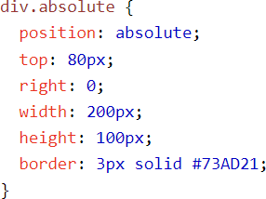

Slide 91
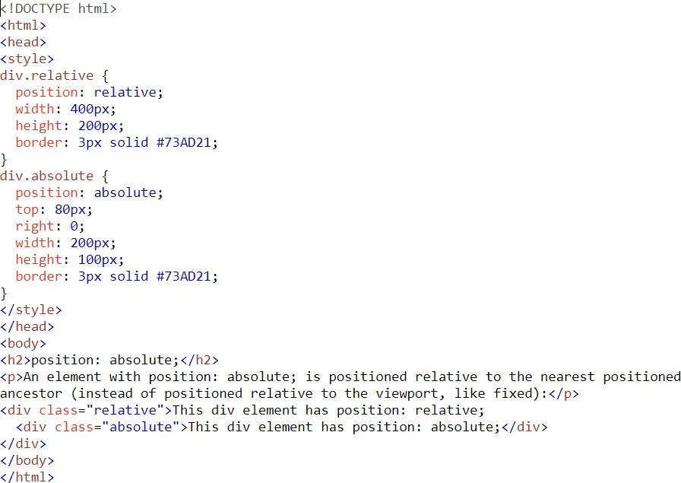
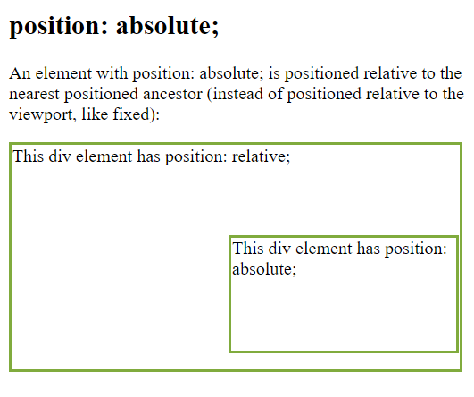

Slide 92
<!DOCTYPE html> <html> <head>
<meta charset = "utf-8">
<title>Relative Positioning</title>
<style type = "text/css">
p { font-size: 1.3em;
font-family: verdana, arial, sans-serif; }
span { color: red;font-size: .6em;height: 1em; }
.super { position: relative;top: -1ex; }
.sub { position: relative;bottom: -1ex; }
.shiftleft { position: relative;left: -1ex; }
.shiftright {position: relative;right: -1ex; }

Slide 93
</style> </head>
<body>
<p>The text at the end of this sentence <span class = "super">is in superscript</span></p>
<p>The text at the end of this sentence <span class = "sub">is in
subscript</span></p>
<p>The text at the end of this sentence<span class = "shiftleft">is shifted left</span></p>
<p>The text at the end of this sentence<span class = "shiftright">is
shifted right</span></p> </body> </html>

Slide 94
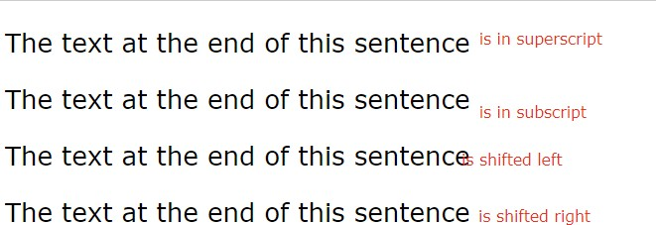

Slide 95
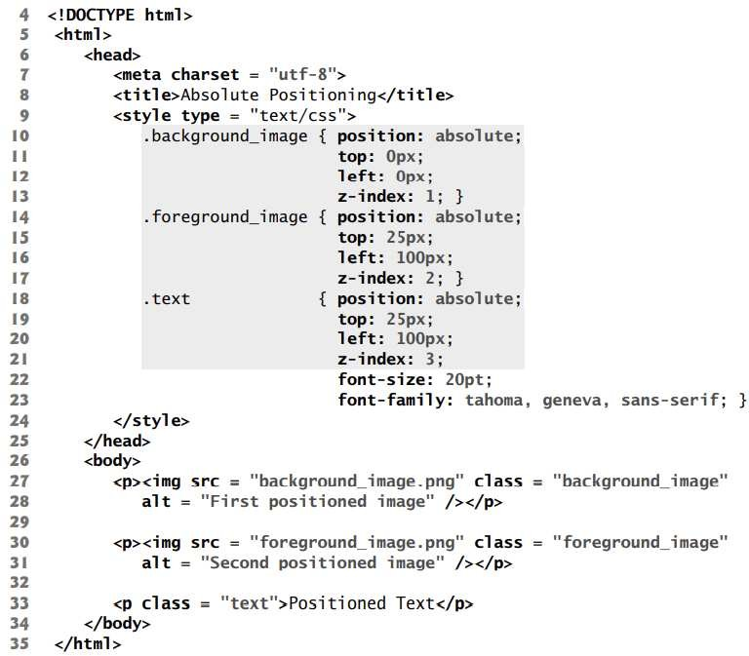
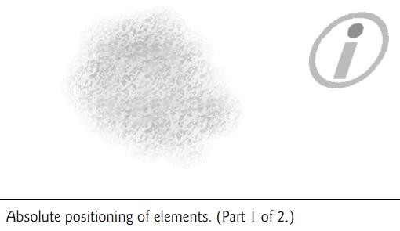
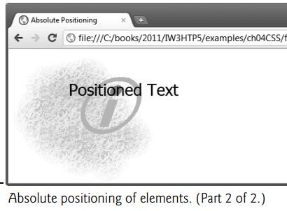

Slide 96
The z-index property allows you to layer overlapping elements.
Elements that have higher z-index values are displayed in front of elements with lower z-index values.
In this example, .background_image has the lowest z-index (1), so it displays in the background. The .foreground_image CSS rule (lines 14–17) gives the circle image (foreground_image.png, in lines 30–31) a z-index of 2, so it displays in front of background_image.png.

Slide 97
The p element in line 33 is given a z-index of 3 in line 21, so its content (Positioned Text) displays in front of the other two.
If you do not specify a z-index or if elements have the same z-index value, the elements are placed from background to foreground in the order in which they’re encountered in the document.
The default z-index value is 0.

Slide 98
Relative positioning
In relative positioning, elements are positioned relative to other elements
An element with position: relative; is positioned relative to its normal position.
Setting the top, right, bottom, and left properties of a relatively-positioned element will cause it to be adjusted away from its normal position. Other content will not be adjusted to fit into any gap left by the element.
Setting the position property to relative, as in class super lays out the element on the page and offsets it by the specified top, bottom, left or right value.
relative positioning keeps elements in the general flow of elements on the page, so positioning is relative to other elements in the flow.

Slide 99
Setting the position property to relative, as in class super , lays out the element on the page and offsets it by the specified top, bottom, left or right value.
Class super lays out the text at the end of the sentence as superscript, and
class sub lays out the text as subscript relative to the other text.
Class shiftleft (lines 19–20) shifts the text at the end of the sentence left and class shiftright (lines 21–22) shifts the text right

Slide 100
Span and Div
<span> and <div> are tags that let you select a group of elements and apply styles to them
<span> is an inline tag
no breaks are added before or after <span></span>
<div> is a block tag
a break is usually added by the browser before and after the <div></div> tags

Slide 101
The <span> tag is similar to other HTML tags,
they can be nested and they have id and class attributes
Another tag that is useful for style specifications:
<div>- Used to create document sections (or divisions) for which style can be specified

Slide 102
<html><head>
<style>
div { line-height: 20px; margin: 30px;
padding-bottom: 20px; text-align: justify; width: 140px;
color: red; }

Slide 103
<body><p>A div element is displayed like this:
<div>This is some text in a div element.This is some text in a div element.This is some text in a div element.This is some text in a div element.This is some text in a div element.This is some text in a div element.</div>
Change the default CSS settings to see the effect.
</p></body></html>

Slide 104
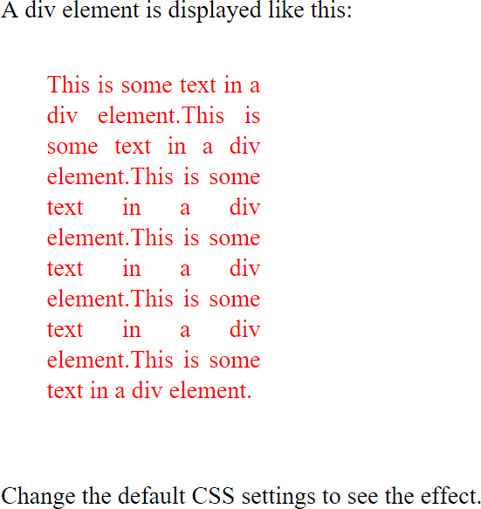

Slide 105
<!DOCTYPE html >
<html >
<head> <title>Selectors.html</title>
<style type="text/css">
.spanred {font-size:24pt;font-family:Arial;color:red;}
.spanbrown {font-size:20pt;font-family:Arial;color:brown;}
</head>
<body>

Slide 106
<p>Markup language refers to the traditional way of marking up a document. It determines the structure and meaning of textual elements . There are two types of markup languages.
<span class="spanred">Specific Markup Language </span>
It is used to generate the code that is specific to a particular application. Examples are
<span class="spanbrown">Generalized Markup Language</span>

Slide 107
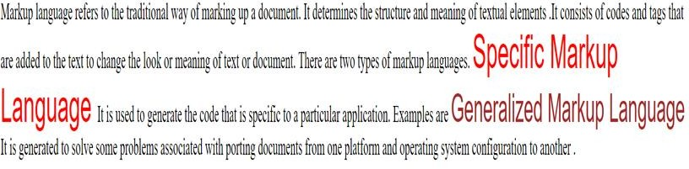

Slide 108
<html><head>
<style>
div {
line-height: 20px; margin: 30px; text-align: justify; width: 140px; color: red;
background-color:green;
}

Slide 109
</style></head><body><p>A div element is displayed like this:
<div>This is some text in a div element.This is some text in a div element.This is some text in a div element.This is some text in a div element.This is some text in a div element.This is some text in a div element.</div>Change the default CSS settings to see the effect.</p></body></html>

Slide 110
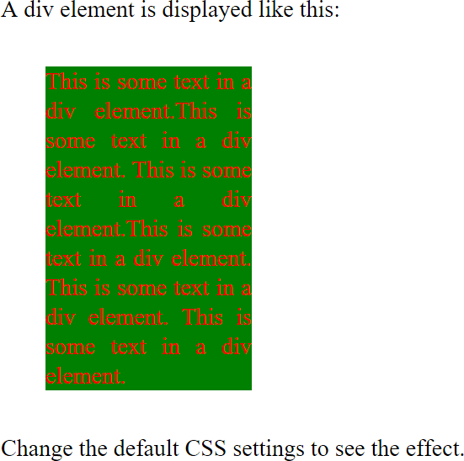

Slide 111

Box Model

Slide 112
The CSS box model is essentially a box that wraps around every HTML element. It consists of: margins, borders, padding, and the actual content.
Content - The content of the box, where text and images appear
Padding - Clears an area around the content. The amount of space between the content of an element and its border , known as padding. The padding is transparent
Border - A border that goes around the padding and content
Margin - Clears an area outside the border. The space between the border and an adjacent element known as margin. The margin is transparent
The box model allows us to add a border around elements, and to define space between elements.

Slide 113
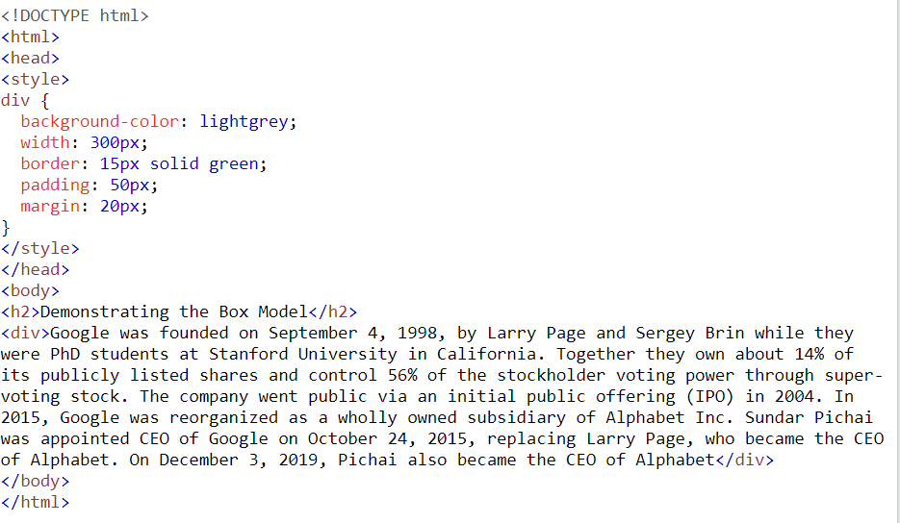


Slide 114
To define the margins of an element, use:
margin : value
where value = a length value (“em” is often used), a percentage (a margin proportional to the element’s width, or auto
To set margins on a side, use:
margin-top
margin-right
margin-bottom
margin-left
E.g., body {margin-left:12px; margin-right:3%; margin-top:10px; margin- bottom:1em}
(“em” is often used), a margin proportional to the element’s width, or auto

Slide 115
To define padding, use:
padding: value
where value = a length value or a percentage (a padding proportional to the element’s width)
To set padding on a side, use:
padding-top
padding-right
padding-bottom
padding-left

Slide 116
Border can be set in three ways:
border-width(thin,thick,medium or length in pixels)
border-style (dotted,dashed,solid,double,default,none)
border-color
Short hands for setting border
Ex: border:5px solid blue ;
td,th { border:thin double black ; }
To set the border, use:
border : width_value style color
To set borders on a side, use:
border-top
border-bottom
border-left
border-right

Slide 117
Border can be set in three ways:
border-width(thin,thick,medium or length in pixels)
border-style (dotted,dashed,solid,double.default-none)
border-color
Short hands for setting border
Ex: border:5px solid blue ;
td,th { border:thin double black ; }
To set the border, use:
border : width_value style color
To set borders on a side, use:
border-top
border-bottom
border-left
border-right

Slide 118
<style type=“text/css”>
table{
padding-left:20px; padding-right:10pt; padding-top:3%; padding-bottom:1%; border-left:dotted; border-right:double; border-top:oblique; border-bottom:solid; border-width:10px; border-color:red
}
</style>

Slide 119
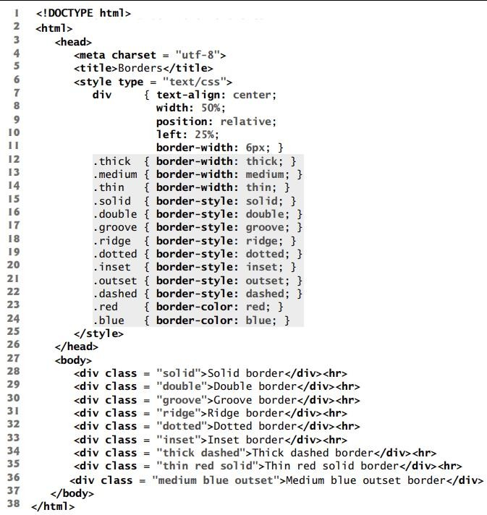
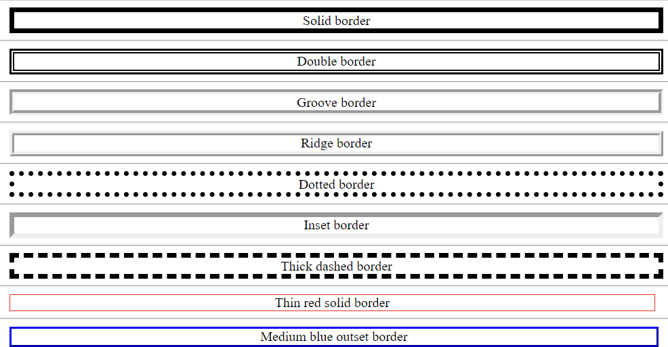

Slide 120
